Slide 1
Introduction to Computer Science
Data representation

Slide 2
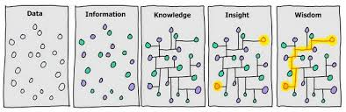
What is data?
What is data
Data is information?
As information take different forms, the most efficient way is to represent all forms of information using a universal format.

Slide 3
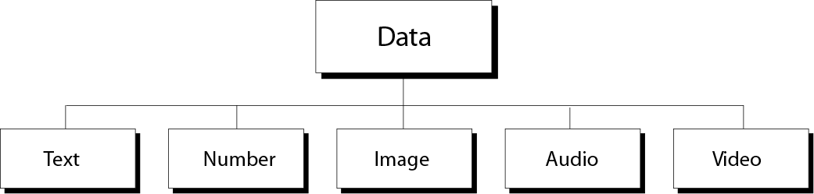
Data Types
Multimedia
Word processing programs
Engineering programs
Image processing programs
Audio play program
Video display programs

Slide 4
Information coding and decoding
Human senses deal with a variety of information (signals).
Input devices of computer translates these information into electrical signals, why electrical?.
Electrical signals are then translated into universal format (0s,1s), this is known as coding.
After processing, output devices transform back data into their original form, this is known as decoding

Slide 5
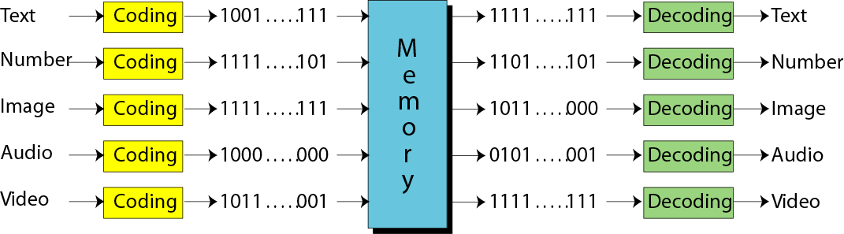
Information coding and decoding

Slide 6
Bit Pattern
A bit is the smallest unit of data that the computer deals with.
a bit can take two values (0 or 1).
A two-state electrical switch (transistor) is used to represent a bit (on state →1, off state →0).
To store 16 bits you need 16 switches, to store million bits you need million switches.
In computer memory data are stored as blocks of bits (bit-patterns), the length of bit-patterns is the number of bits in the bit-patterns.
A bit-pattern of 8 bits length is called a byte

Slide 7
Representing Data: (Text Representation)
Written text is made of alphabetical symbols (letters). For example, in English there are 26 uppercase and 26 lowercase symbols.
Each of those symbols is represented by distinctive bit-pattern (code).
Once alphabetical symbols are represented by a bit-pattern, any word that is made of combination of letters can be represented.

Slide 8
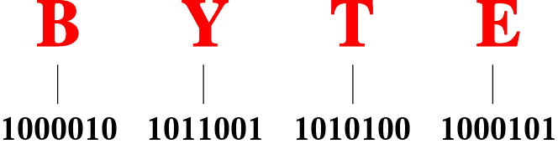
Representation of word “BYTE”

Slide 9
Number of bits in bit-pattern
The number of possible bit-patterns (symbols) made of N number of bits, M is given by:
M = 2^{N}
Inversely, the number of bits needed to construct M number of symbols is given by:
N= Log₂ M ≈ 3.2 Log₁₀ M
(Note: N must be rounded to next bigger integer)
Ex: for M = 26, what is the min number of bits?
N= Log₂ 26 = 3.2 Log₁₀ 26 = 4.5 = 5 bits

Slide 10
Code systems for text representation
There are about 5 code systems used to represent alphabetical symbols:
ASCII (American Standard Code for Information Interchange)
Extended ASCII
EBCDIC (Extended Coded Decimal Interchange Code)
Unicode (Universal Code)
ISO (International Organization for Standardization)

Slide 11
(1) ASCII
In ASCII codes each code is made of 7 bits.
Number of possible codes M = 2⁷ = 128 codes.
Bit-patterns ranging from 0000000 to 1111111
The first pattern represents (null character)
The last pattern represents (delete character)

Slide 12
(2) Extended ASCII
Is invented to make the bit-pattern length equal to 8 bits (Byte), by adding a bit to the left of the ASCII code representation.
Ex. If ASCII code is 1111111 the extended ASCII code is 01111111.
Extended ASCII is not used because it is not standardized as each manufacturer has different 8-bits system.

Slide 13
(3) EBCDIC
Uses 8 bit patterns → # of codes = 2⁸=256
Just used in IBM mainframe (system)

Slide 14
(4) Unicode
To represent more languages’ character beside English, Unicode is invented.
Uses 16 bit pattern → # of codes = 2¹⁶=65536
enough to represent all world’s languages.
Some codes are allocated for geographical and special symbols.
Java uses Unicode, Microsoft uses the first 256 symbols.

Slide 15
(5) ISO
ISO uses 32 bit patterns
→ # of codes = 2³²=4,294,967,296 symbols enough to represent all world’s symbols.

Slide 16
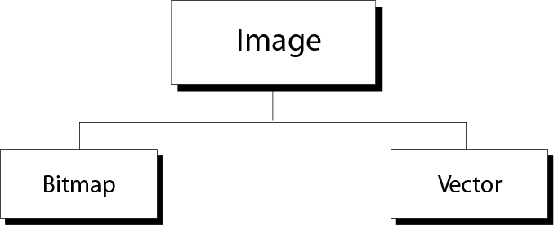
Representing Data: (Image Representation)
Image representation methods

Slide 17
Bitmap Graphic
Image is divided into matrix of pixels.
A pixel represents a dot which is the smallest unit of the image.
Image resolution depends on the number of pixels in the image.
Higher resolution images require larger memory.
Once image is divided into pixels, each pixel is given a bit-pattern.
The pixel bit-pattern determines the color of the pixel

Slide 18
Pixel Color (Black & white)
For black and white images, only two bit-patterns are needed, one to represent a black pixel and the other to represent a white pixel.
In this case, the length of the pattern could be only one bit, i.e. 1 pattern to represent a black pixel and 0 pattern to represent a white pixel.
The rows of patterns are then stored in the memory.

Slide 19
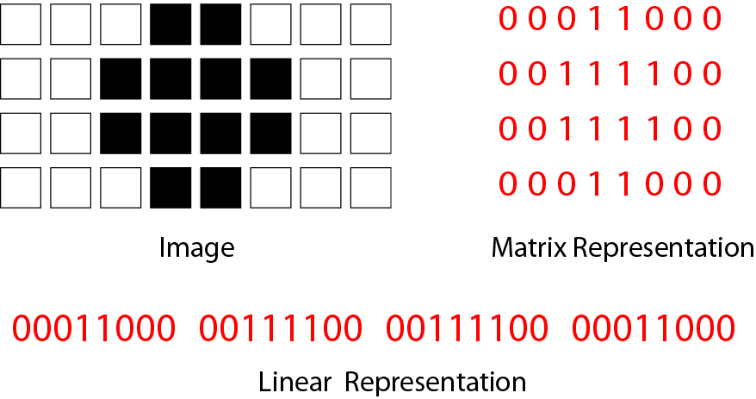
Bitmap graphic method of a black-and-white image

Slide 20
Gray scale) Pixel Color)
To represent a gray-scale image of 4 colors (for example) we need to increase the length of bit-pattern representing the pixel to be 2 bits.
In this case
00→ black pixel
01→ dark gray pixel
10→ light gray pixel
11→ white pixel

Slide 21
Pixel Color (Colored pixel)
Any visible color could be constructed from the 3 basic colors Red, Green, Blue (RBG)
The difference between one color another depends on the intensity of the RBG colors in the color
Therefore, to represent a colored image, each pixel in the image must be represented by 3 different bit-patterns. Each of them represent the intensity of the basic colors.
The length of a bit pattern representing each basic color is usually 8 bits

Slide 22
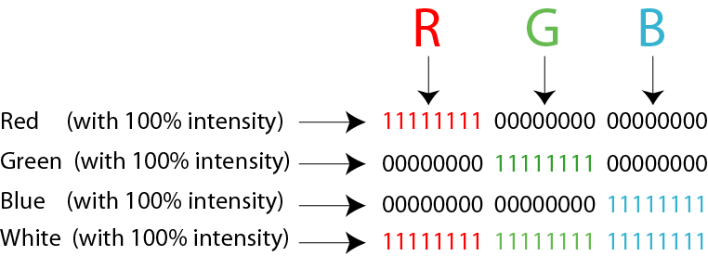
Representation of color pixels

Slide 23
Vector Graphic
Image is decomposed into lines and curves.
Each curve and line is represented by a mathematical formula.
The mathematical formula is sorted.
No bit-patterns are stored
For example a line is described by its coordinates, the circle is described by it’s the coordinates of its centre and length of the radius.
The advantage of vector representation is that image can be scaled by multiplying the formula by the scale factor without effecting the image resolution as in bitmap representation

Slide 24
Representing Data: Audio Representation
Audio is sound
Sound signal is analog signal
The representation of audio signal requires converting analog signal into digital signal (A/D)

Slide 25
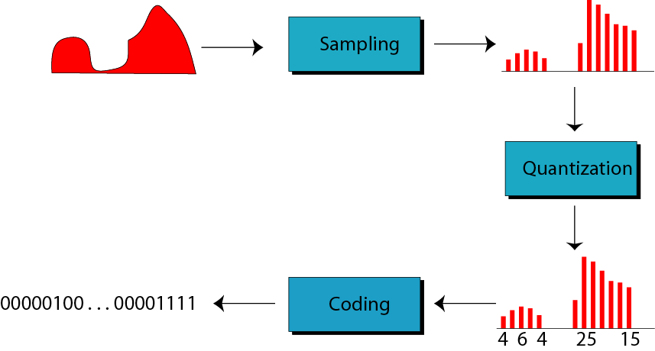
Audio representation

Slide 26
Representing Data: Video Representation
Video is a series of images (frame) shown sequentially (one after another)
Thus video data representation is basically the representation of images changed with time.
Video files are multimedia files

